Slide 1
Discrete Mathematics
Ass. Prof. Khaled Elshafey
Lecture (1)

Slide 2
Course Objectives
This course aims to provides a strong foundation to understand A discrete mathematics.
Such a course should teach students how to think logically and mathematically.
one of the primary goals of this course is to teach mathematical reasoning and problem solving.

Slide 3
Course Topics:
The Foundations: Logic and Proofs
Basic Structures
Algorithms
Number Theory and Cryptography
Induction and Recursion
Counting & Relations
Graphs & Trees

Slide 4
Reference
Kenneth H. Rosen, “ Discrete Mathematics and Its Applications”, 7th Edition

Slide 5
Course Plan
Final Exam: 40
Mid Term : 30
Assignments 10
Quizzes 10
Participations 10
----------------------------------------------------
Total 100

Slide 6
What is discrete mathematics?
Discrete mathematics is the part of mathematics devoted to the study of discrete objects. (Here discrete means consisting of distinct or unconnected elements.)
More generally, discrete mathematics is used whenever objects are counted, when relationships between finite (or countable) sets are studied, and when processes involving a finite number of steps are analyzed.
A key reason for the growth in the importance of discrete mathematics is that information is stored and manipulated by computing machines in a discrete fashion.

Slide 7
WHY STUDY DISCRETE MATHEMATICS?
Discrete mathematics is the gateway to more advanced courses in all parts of the mathematical sciences.
Discrete mathematics provides the mathematical foundations for many computer science courses including data structures, algorithms, database theory, automata theory, formal languages, compiler theory, computer security, AI, and operating systems.
Discrete mathematics contains the necessary mathematical background for solving problems in operations research (including many discrete optimization techniques).

Slide 8
Chapter 1
The Foundations:
Logic and Proofs

Slide 9
Logic:
Logic is the basis of all mathematical reasoning, and of all automated reasoning.
Automated reasoning is the area of computer science that is concerned with applying reasoning in the form of logic to computing systems.
If given a set of assumptions and a goal, an automated reasoning system should be able to make logical inferences towards that goal automatically.

Slide 10
Proofs:
To understand mathematics, we must understand what makes up a correct mathematical argument? that is, a proof.
Once we prove a mathematical statement is true, we call it a theorem.
Proofs are used to verify that computer programs produce the correct output for all possible input values.

Slide 11
Propositional Logic
The rules of logic give precise meaning to mathematical statements to distinguish between valid and invalid mathematical arguments.
Our discussion begins with an introduction to the basic building blocks of logic—propositions.
A proposition is a declarative sentence (that is, a sentence that declares a fact) that is either true or false, but not both.

Slide 12
EXAMPLE 1
1. Washington, D.C., is the capital of the United States of America → T
2. Toronto is the capital of Canada → F.
3. 1 +1 = 2 → T
4. 2 + 2 = 3 → F
Therefore, all the above declarative sentences are propositions.

Slide 13
EXAMPLE 2
Consider the following sentences.
1. What time is it?
2. Read this carefully.
3. x + 1 = 2.
4. x + y = z.
Note:
- Sentences 1 and 2 are not propositions because they are not declarative sentences.

Slide 14
Cont.,
Sentences 3 and 4 are not propositions because they are neither true nor false.
Note that each of sentences 3 and 4 can be turned into a proposition if we assign values to the variables

Slide 15
How to denote Proposition
We use letters to denote propositional variables (or statement variables), that is, variables that represent propositions, just as letters are used to denote numerical variables.
The conventional letters used for propositional variables are p, q, r, s, . . . .
The truth value of a proposition is true, denoted by T, if it is a true proposition, and the truth value of a proposition is false, denoted by F, if it is a false proposition

Slide 16
Propositional calculus
The area of logic that deals with propositions is called the propositional calculus or propositional logic.
It consists of a set of input Propositions plus Propositional (Logic or Boolean) operator.
Many mathematical statements are constructed by combining one or more propositions.
It is the method for producing new propositions from those that we already have.

Slide 17
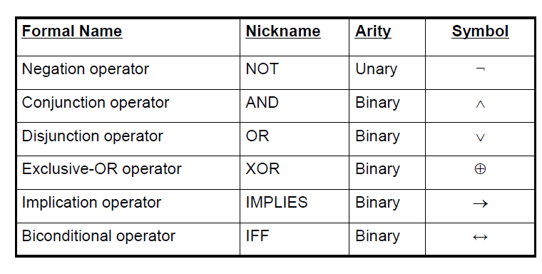
Some Popular Logic Operators

Slide 18

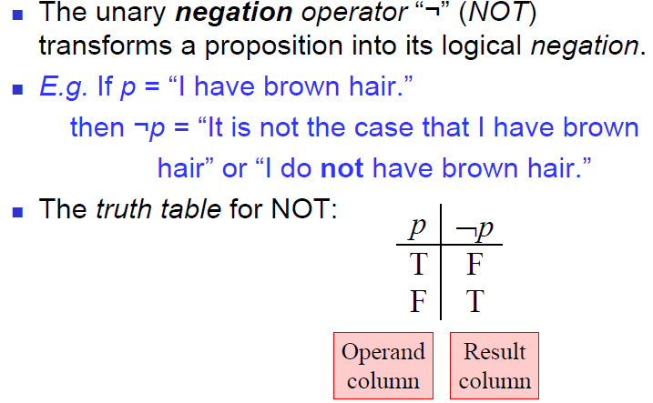

Slide 19

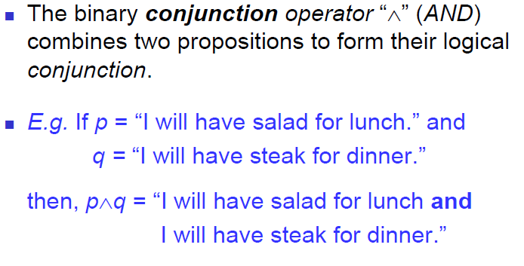

Slide 20
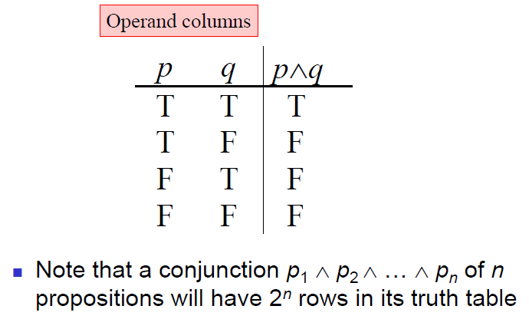

Slide 21
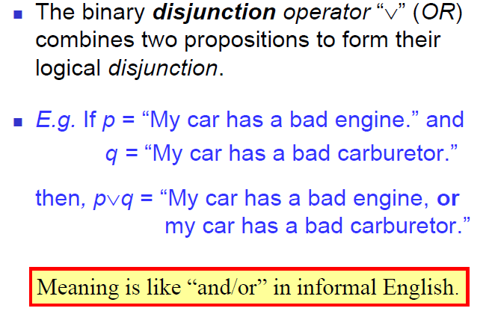

Slide 22
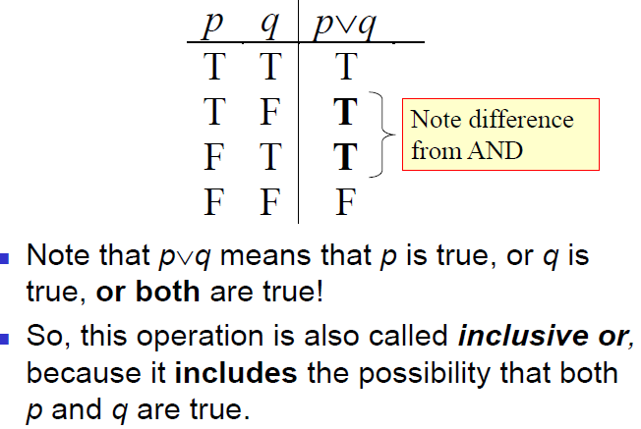

Slide 23
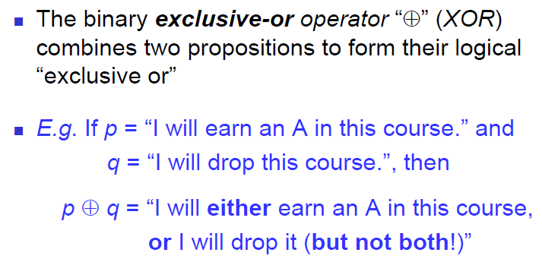

Slide 24
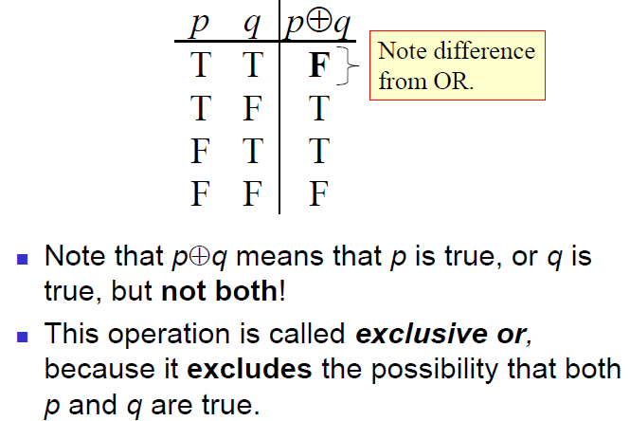

Slide 25
Conditional Statements
Let p and q be propositions. The conditional statement p → q is the proposition “if p, then q. or p implies q”.
The conditional statement p → q is false when p is true, and q is false, and true otherwise.
In the conditional statement p → q, p is called the hypothesis (or antecedent or premise) and q is called the conclusion (or consequence).

Slide 26

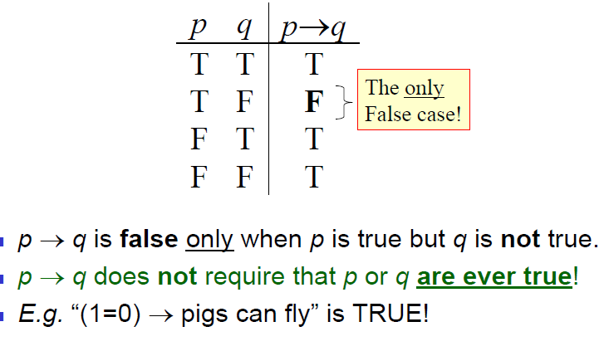

Slide 27
Example:
“If I am elected, then I will lower taxes.”
If the politician is elected, voters would expect this politician to lower taxes. Furthermore, if the politician is not elected, then voters will not have any expectation that this person will lower taxes.
If the politician is elected but does not lower taxes, that voters can say that the politician has broken the campaign pledge.
This last scenario corresponds to the case when p is true, but q is false in p → q.

Slide 28
Different Forms of Conditional Statement
“if p, then q” “p implies q”
“if p, q” “p only if q”
“q if p” “q whenever p”
“q when p” “q is necessary for p”
“a necessary condition for p is q”
“q follows from p”
“q unless ￢p”
“p is sufficient for q”
“a sufficient condition for q is p”

Slide 29
Example: “p only if q”
“p only if q” means that p cannot be true when q is not true.
That is, the statement is false if p is true, but q is false.
When p is false, q may be either true or false, because the statement says nothing about the truth value of q.

Slide 30
Example: “q unless ￢p”
“q unless ￢p” means that:
if ￢p is false, then q must be true.
That is, the statement:
“q unless ￢p” is false when p is true, but q is false, and it is true otherwise.

Slide 31
Example:
Let p be the statement “Maria learns discrete mathematics” and q the statement “Maria will find a good job.”
Express the statement p → q as a statement in English?
Solution:
“If Maria learns discrete mathematics, then she will find a good job.”
“Maria will find a good job unless she does not learn discrete mathematics.”

Slide 32
Note:
The if-then construction used in many programming languages is different from that used in logic.
Most programming languages contain statements such as if p then S, where p is a proposition and S is a program segment (one or more statements to be executed).
When execution of a program encounters such a statement, S is executed if p is true, but S is not executed if p is false.

Slide 33
The contrapositive of p → q
The contrapositive of p → q is the proposition ￢q →￢p.
The contrapositive always has the same truth value as p → q.
So that a conditional statement and its contrapositive are equivalent
P ￢p | Q ￢q | p → q. | ￢q →￢p
T f | T F | T | T
T f | F T | F | F
F t | T F | T | T
F t | F T | T | T

Slide 34
The Inverse and Converse of p → q.
The proposition ￢p →￢q is called the inverse of p → q.
the inverse always do not have the same truth value as p → q.
The proposition q → p is called the converse of p → q.
the converse do not have the same truth value as p → q.

Slide 35
Self Study
Prove that the converse and the inverse of a conditional statement p → q are also equivalent, use truth table.
Prove that p → q ≡ ￢p ∨ q
p | q | ￢p | ￢q | p → q | ￢p ∨ q | q → p
T | T | F | F | T | t | T
T | F | F | T | F | F | T
F | T | T | F | T | T | F
F | f | T | T | T | t | T

Slide 36
Example
What are the contrapositive, the converse, and the inverse of the conditional statement:
“The home team wins whenever it is raining?”
Solution:
Because “q whenever p” is one of the ways to express the conditional statement p → q, the original statement can be rewritten as:
“If it is raining, then the home team wins.”

Slide 37
Cont.,
The contrapositive of this conditional statement is
“If the home team does not win, then it is not raining.”
The converse is
“If the home team wins, then it is raining.”
The inverse is
“If it is not raining, then the home team does not win.”

Slide 38
Biconditional Operator
Let p and q be propositions. The biconditional statement p ↔ q is the proposition:
“p if and only if q.” == p iff q
The biconditional statement p ↔ q is true when p and q have the same truth values and is false otherwise.
Biconditional statements are also called bi-implications.

Slide 39
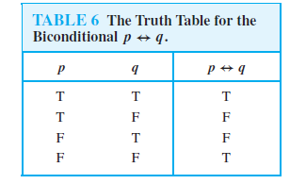
Cont.,

Slide 40
Note
the statement p ↔ q is true when both the conditional statements p → q and q → p are true and is false otherwise.
That is why we use the words “if and only if” to express this logical connective and why it is symbolically written by combining the symbols → and←.

Slide 41
Example 1
Let p be the statement “You can take the flight,” and let q be the statement “You buy a ticket.”
Then p ↔ q is the statement
“You can take the flight if and only if you buy a ticket.”

Slide 42
Example 2
Consider the statement in English
“If you finish your meal, then you can have dessert.”
What is really meant is “You can have dessert if and only if you finish your meal.”
This last statement is logically equivalent to the two statements “If you finish your meal, then you can have dessert” and “You can have dessert only if you finish your meal.”

Slide 43
Sheet # 1
Textbook: Exercises Page # 12.

